Slide 1
Chapter 2 Objectives
The CCNA Topics Covered in this chapter include:
  Network Topologies
  LAN,MAN & WAN
  What is VPN?
  Definition of Bandwidth

Slide 2
Network Topologies
Network topology defines the structure of the network.
One part of the topology definition is the physical topology, which is the actual layout of the wire or media.
The other part is the logical topology, which defines how the media is accessed by the hosts for sending data.
Bus Topology
Ring Topology
Star Topology
Mesh Topology
Hybrid Topologies

Slide 3

Bus Topology
A bus topology uses a single backbone cable that is terminated at both ends.
All the hosts connect directly to this backbone.
Terminator
Terminator
Segment

Slide 4

Ring Topology
A ring topology connects one host to the next and the last host to the first.
This creates a physical ring of cable.

Slide 5


Star Topology
A star topology connects all cables to a central point of concentration.
Hub

Slide 6

Mesh Topology
A mesh topology is implemented to provide as much protection as possible from interruption of service.
Each host has its own connections to all other hosts.
Although the Internet has multiple paths to any one location, it does not adopt the full mesh topology.

Slide 7


Hybrid Topologies
Star-Bus
Bus
Star-Ring

Slide 8
LAN, MAN, WAN
LAN: (local area network) A group of computers that share a common connection and are usually in a small area or even in the same building. For example an office or home network. They are usually connected by Ethernet cables and have high speed connections. If it was a wireless setup it would be called a WLAN, which would have a lower connection speed.
MAN: (metropolitan area network) This is a larger network that connects computer users in a particular geographic area or region. For example a large university may have a network so large that it may be classified as a MAN. The MAN network usually exist to provide connectivity to local ISPs, cable tv, or large corporations. It is far larger than a LAN and smaller than a WAN.
WAN: (wide area network) This is the largest network and can interconnect networks throughout the world and is not restricted to a geographical location. The Internet is an example of a worldwide public WAN. Most WANs exist to connect LANs that are not in the same geographical area. This technology is high speed and very expensive to setup.

Slide 9
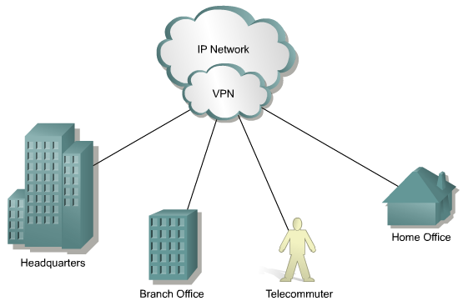




Virtual Private Network
A VPN is a private network that is constructed within a public network infrastructure such as the global Internet. Using VPN, a telecommuter can access the network of the company headquarters through the Internet by building a secure tunnel between the telecommuter’s PC and a VPN router in the headquarters.
Virtual Private Network
Internet
Tunnel
Remote
Access Client
VPN Server
Corporate
Intranet

Slide 10
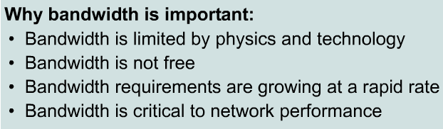

Bandwidth

Slide 11
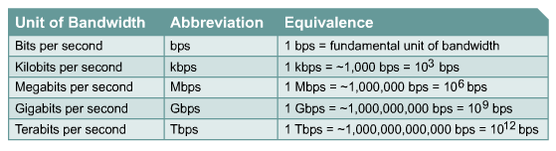
Measuring Bandwidth

